Slide 1


Project Title
Exploring the use of Mobile Banking satisfaction among students of University of Rajshahi
Presented by
Name: Sojib Hossain
Examination Roll No: 2010924181
Session: 2019-2020
Examination Year: 2023
Department of Statistics
University of Rajshahi
Rajshahi-6205,
Bangladesh
1

Slide 2
Outline of the presentation
Background of the study
Objectives of the study
Literature review
Research gap
Materials and Methods
Research findings and discussion
Main findings
Further study
Key references
2

Slide 3
Background of the study
The rapid growth of mobile banking is reshaping the financial services. Features like cost efficiency and adaptability to user preferences significantly influence satisfaction levels. Perceived justice in addressing service failures plays a significant role in shaping customer loyalty and trust in mobile banking apps. Demographic factors, such as age and education, also impact the adoption and satisfaction rates of mobile banking users.
3

Slide 4

Research Objective
The main objective of the study is to explore, evaluate, and provide practical insights associated with overall satisfaction of mobile banking services at University of Rajshahi.
To achieve the main purpose of research, the specific objectives are:
To assess students' satisfaction levels with the use of mobile banking at Rajshahi University.
To identify key factors influencing satisfaction (e.g., usability, security, transaction speed).
To gather insights on any additional features or innovative solutions that students would like to see integrated into mobile banking apps.
Recommend ways to enhance mobile banking experiences for students.
4

Slide 5
Literature Review
(Islam et al., 2019) studied on “Factors Affecting Customers’ Experience in Mobile Banking of Bangladesh” and explored the factors that influence the adoption and continued use of mobile banking services. Key drivers included trust, perceived ease of use, security, and cost.
Hai, M. A., & Rahman, M. M. (2016) studied on “Measuring the Satisfaction Levels of Mobile Financial Services Users in Bangladesh: An Empirical Study” and revealed that while mobile banking has become increasingly popular, key factors like service quality, reliability, and responsiveness significantly impact customer satisfaction.
Dahlberg, T., Guo, J., & Ondrus, J. (2015) studied on “A critical review of mobile payment research. Electronic Commerce Research and Applications” and focused on key themes such as consumer adoption, technology integration, and trust in mobile payment systems.
Shaikh, A. A., & Karjaluoto, H. (2015) studied on “Mobile banking adoption: A literature review. Telematics and Informatics” and discussed how mobile banking serves as a critical alternative delivery channel for financial transactions, offering benefits like increased access to banking services for previously unbanked populations, improved customer retention, and operational efficiency.
5

Slide 6


Research gap
After doing
Literature Review
Limited research on mobile banking satisfaction specifically among students.
Only a few studies focused on mobile banking in the South Asian context.
Student-specific needs like ease of use, cost sensitivity, and quick support are underexplored.
Limited examination of the impact of mobile banking on students' financial literacy.
6

Slide 7
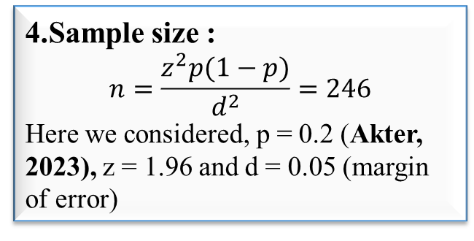
Materials and Methods
1.Study area :
University of Rajshahi, Bangladesh
2.Type of study:
Cross-sectional study: March,2024
3.Study population :
All Undergraduate and Graduate students
6.Data collection:
A self-administer partially structured questionnaire
Pilot survey to improve the efficiency of the main survey
4.Sample size :
$$n=\frac{z^{2}p(1−p)}{d^{2}}=246$$
Here we considered, p = 0.2 (Akter, 2023), z = 1.96 and d = 0.05 (margin of error)
5.Sampling procedure:
Two-stage sampling where
Halls were the 1st stage and Students were the 2nd stage unit
7.Data management:
Data was coded and entered into computer by SPSS
Cleaning all inconsistent, missing observation from data sets.
8.Data analysis technique:
Descriptive statistics
Frequency distribution
Association
Logistic regression
7

Slide 8
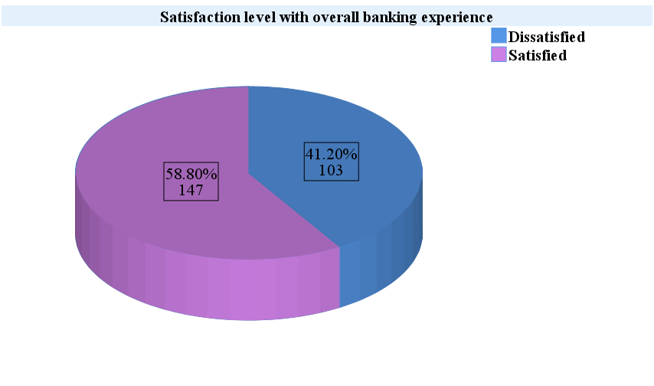
Research Findings & Discussion
Fig 1: Satisfaction level with overall mobile banking experience
8

Slide 9
Research Findings & Discussion
Table 1: Demographic information of the respondents
Table 2: Frequency distribution of academic level and faculty of the respondents
Variables |  | Frequency | Percentage
Religion | Muslim | 219 | 87.6
 | Hindu | 29 | 11.6
 | Others | 2 | 0.8
Gender | Male | 194 | 77.6
 | Female | 56 | 22.4
Residence | Rural | 151 | 60.4
 | Urban | 99 | 39.6
9

Slide 10
Research Findings & Discussion
Table 3: Banking information of the respondents
Continue…Table 3
10

Slide 11
Research Findings & Discussion
Table 4: Association between academic level & banking variables and satisfaction level with overall mobile banking of the respondents
11

Slide 12
Research Findings & Discussion
Table 4: The effect of academic level and different banking activities on satisfaction level with mobile banking
12

Slide 13
Main Findings
There was a significant association between academic level, frequency of use of mobile banking, confidence level on security, experience about customer care support, speed of transaction and satisfaction level with overall mobile banking experience
Graduate students are more likely to be satisfied compared to undergraduate students.
Students who use mobile banking on a daily basis are more likely to be satisfied compared to students who use rarely.
Students who use mobile banking weekly are more likely to be satisfied compared to students who use rarely.
Students who are not confident on security with mobile banking are less likely to be satisfied compared to students who are very confident.
Students who are somewhat confident on security with mobile banking are times less likely to be satisfied compared to students who are very confident.
13

Slide 14
Further study
Researcher should conduct this research study in a large part of population
To consider more related factors for finding the predictors of satisfaction level with mobile banking.
To apply advanced statistical model in order to find more accurate results
14

Slide 15
Key references
Akter, R. (2023). A Study on Mobile Banking in Bangladesh. Cross Current International Journal of Economics, Management and Media Studies, 5(02), 39–43. https://doi.org/10.36344/ccijemms.2023.v05i02.005
Islam, N., Ameen, M., Mustafi, A., Rahman, M. N., Nower, N., Mostafa, A., Rafi, M., Tasnim, N., Hassan, R., & Afrin, S. (2019). Factors Affecting Customers’ Experience in Mobile Banking of Bangladesh.
Hai, M. A., & Rahman, M. M. (2016). Measuring the Satisfaction Levels of Mobile Financial Services Users in Bangladesh: An Empirical Study. Https://Services.Igi-Global.Com/Resolvedoi/Resolve.Aspx?Doi=10.4018/IJOM.2016010102, 6(1), 24–33. https://doi.org/10.4018/IJOM.2016010102
Dahlberg, T., Guo, J., & Ondrus, J. (2015). A critical review of mobile payment research. Electronic Commerce Research and Applications, 14(5), 265–284. https://doi.org/10.1016/J.ELERAP.2015.07.006
Shaikh, A. A., & Karjaluoto, H. (2015). Mobile banking adoption: A literature review. Telematics and Informatics, 32(1), 129–142. https://doi.org/10.1016/J.TELE.2014.05.003
15

Slide 16
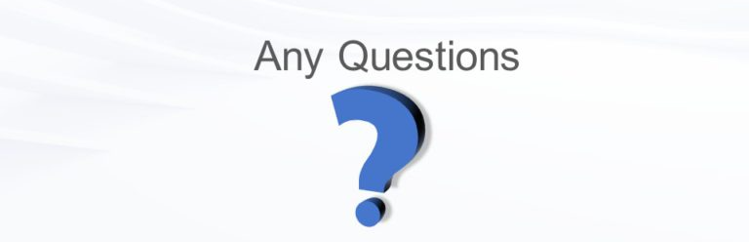
Thank You
For Your Attention!
16

